Slide 1
Churn - Cell2Cell Project Summary
March 9, 2019

Slide 2
Executive Summary
Various machine learning models are used to study costumer churn data.
Logistic regression is used to do detail study because: a) easy to get the whole CAP curve, b) can provides clear insights on what are key factors for churn;
Careful feature engineering is a key for success in this project
Findings and recommendations are summarized below:
Area | Finding | Action
Months In Service | Customers in 12-17 months in highest risk to churn. | special attention & efforts to retain
Equipment | Customers with old handset are easier to churn | give incentives for upgrading
City | MIA, FLN and BOS have higher and APC has lower than average churn risk | Follow up
Customer Service | Customers received retention call have higher churn risk. Customer care call helps slightly . | A/B test study on effectiveness of retention efforts.
Usage | Increase minutes lead to lower churn risk, however, Increase revenue correlated to higher churn risk. | Follow up study for future product and pricing strategy
PrizmCode | Suburban has lower churn rate than others | Study together with above
Experience | Dropped and blocked calls lead to higher churn.
Demographics | Family with children have higher possibility to churn. Married also have higher possibility to churn. Older customers are less likely to churn.
Financial Status | higher income & higher credit rating, less likely to churn. Customers responded to mail offers have lower risk.
Occupation | No clear impact

Slide 3
Outline
Problem statement
Data cleaning, visualizing and EDA
Feature engineering
Model exploration and evaluation
Discoveries and recommendations

Slide 4
Introduction
Nowadays, telecom industry faces fierce competition in satisfying its customers. The role of churn prediction is not only restricted to accurately predict churners but also to interpret customer churn behavior.
The objectives of this project is how to use machine learning to predict and to find the root causes of churn.
The dataset used is from kaggle. (https://www.kaggle.com/jpacse/datasets-for-churn-telecom)

Slide 5
Data Visualization and EDA
In this project, as the size of the training data set is manageable, data visualization, data exploratory analysis and some feature engineering tasks can be done conveniently with Excel. Following have been done:
Data visualization and explore:
Data range and distribution
Correlations among variables
Missing or wrong data, outlines, etc.
Examine each feature and decide if it is numerical or categorical
Income level, handset price, … are numerical, even though they are groups.
Encode categorical data
Data cleaning:
Remove outlines / wrong data
Replace Missing data by mean or median

Slide 6
Feature Engineering
Feature engineering is critical in this project.
Service area
There is 731 service areas represented by 9 digits id, such as “PITHOM412”. It is found that the first 3 digit is the city code and the last 3 digit is area code.
Created a new feature as city code (17 cities).
MonthInService and CurrentEquipmentDays
Found that churn rate vs. MonthInService is nonlinear
Created a new categorical feature by binning MonthInService into 5 groups
Similarly on CurrentEquipmentDays
Add 2nd order term for nonlinear variables, such as:
MonthlyRevenue; MonthlyMinutes;
TotalRecurringCharge
Add absolute value (ABS) as feature for:
PercChangeMinutes; PercChangeRevenues
Group
5
4
3
2
1
4
3
2
1

Slide 7
Build Models
Four models we have been explored:
KNN
Kernel SVM
Random forest
Logistic regression
KNN and Kernel SVM are not well suitable for this project, as distance definition is difficult. The results will highly depend on how to normalized the inputs.
Logistic regression is best:
Easy to get the whole CAP curve by adjusting the possibility threshold;
Results are easy to understand (to link to the root cause);
Feature selection: use statistical method to remove features which is not significant
Use stepwise backward elimination process based on p-value
Remove the lest significant feature (max p-value) at each iteration
Until all features have p-value smaller than the criteria
Grid search on p-value criteria (0.01, 0.05 and 0.32). Found that 0.05 is best.
Thanks Tue Ngo for implementing the initial python code to automate the feature selection/elimination process.

Slide 8
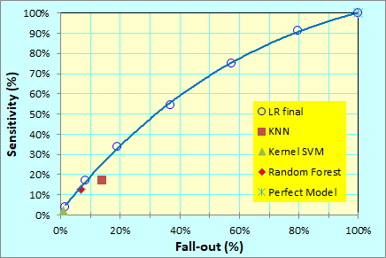
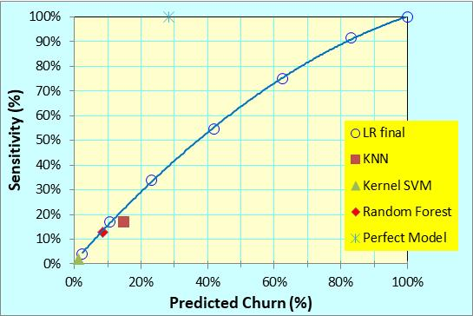
Model Evaluation -- Confusion Matrix, ROC & (CAP) Curve
Confusion matrix
Confusion matrix for various models and model parameters are listed in the table.
Receiver Operating Characteristic (ROC) and Cumulative Accuracy Profile (CAP) plotted.
Logistic regression performs best.
Perfect
Perfect model
ROC
CAP
Random
Random model

Slide 9
Model Evaluation -- Confusion Matrix & Cumulative Accuracy Profile (CAP) Curve
To select the best model for this classification problem, CAP curves of various models are compared.
Models we have tried includes:
KNN
Kernel SVM
Random forest
Logistic regression
Logistic regression with added terms for nonlinearity
We quickly given up KNN and Kernel SVM as distance definition is difficult.
Logistic regression is best:
Easy to get the whole CAP curve by adjusting the possibility threshold;
Results are easy to understand;
Grid search on p-value criteria (0.01, 0.05 and 0.32). Found that 0.05 is best.
Perfect model
Random model

Slide 10
Logistic Regression Results – Importance by Variables
Discovering the root-cause of churn is a key objective. Each feature is ranked by its importance.
There are 81 variables originally. 41 variables removed as their p value > 0.05.
Odd Ratio (OR) = exp(LR-parameters); SD = 1 for categorical variables, and SD = stdev for non categorical
Importance = OR^SD if OR > 1; Importance = 1/OR^SD if OR < 1; for removed variables, Importance = OR = 1
The following variables are dropped from the model because p > 0.05
Results are discussed in more details in the following pages.

Slide 11
The Key Findings and Recommendations
Months In Service (Customer life cycle)
Customers in the 12-17 months have highest possibility to churn.
Need to pay special attention and efforts to retain them.
Area (City)
Group original 731 service areas into 16 major cities and Others.
Found 3 cities (MIA, FLN and BOS) have higher and one city (APC) has lower than normal churn rate.
Need to follow up.
Not significant
Not significant
Handsets (Equipment)
Customers with old handset are easier to churn.
Suggest give incentives to customers to upgrade their handsets.
Not significant

Slide 12
More Findings
Customer Service
Customers who we made retention call still have higher possibility to churn.
Suggest to have A/B test study to find out effectiveness of our retention efforts.
Customer care call helps slightly .
Usage
Added 2nd order terms for the nonlinearity.
Notice that increase minutes lead to lower churn possibility, however, increase revenue correlated to higher churn possibility.
Recommend follow up study for future product and pricing strategy.
Customer Behavior and experience
Dropped and blocked calls lead to higher churn.

Slide 13
Additional Observations
Customer Demographics
Family with children have higher possibility to churn. Married also have higher possibility to churn
Older customers are less likely to churn.
Customer Financial Status
Customers with higher income and higher credit rating are less likely to churn.
Customers who responded to mail offers are less likely to churn.
PrizmCode
Suburban has lower churn rate than others.
Customer Occupation
No clear impact.

Slide 14
Summary
After data exploratory analysis, applied careful feature engineering
Various machine learning models are used to study costumer churn
In-depth study with Logistic regression: a) ROC and CAP curves; b) key factors for churn
Discoveries and recommendations are summarized below:
Area | Finding | Action
Months In Service | Customers in 12-17 months in highest risk to churn. | special attention & efforts to retain
Equipment | Customers with old handset are easier to churn | give incentives for upgrading
City | MIA, FLN and BOS have higher and APC has lower than average churn risk | Follow up
Customer Service | Customers received retention call have higher churn risk. Customer care call helps slightly . | A/B test study on effectiveness of retention efforts.
Usage | Increase minutes lead to lower churn risk, however, Increase revenue correlated to higher churn risk. | Follow up study for future product and pricing strategy
PrizmCode | Suburban has lower churn rate than others | Study together with above
Experience | Dropped and blocked calls lead to higher churn.
Demographics | Family with children have higher possibility to churn. Married also have higher possibility to churn. Older customers are less likely to churn.
Financial Status | higher income & higher credit rating, less likely to churn. Customers responded to mail offers have lower risk.
Occupation | No clear impact

Slide 15
Appendix
Link to original dataset in kaggle. (https://www.kaggle.com/jpacse/datasets-for-churn-telecom)
Modified dataset after adding new features

